Slide 1
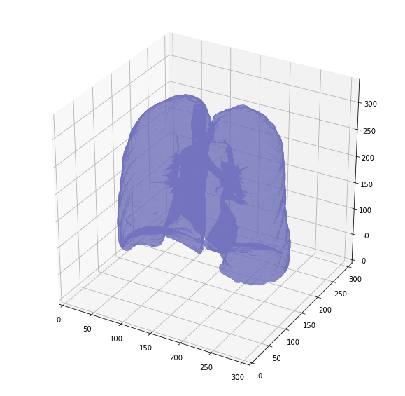
Convolutional Neural Networks in Lung Cancer Detection
Daniel Nasiatka, Mitchell Healy, Adnan Tahir
Georgia Institute of Technology
OMSCS CSE-6250: Big Data for Health Informatics
Presentation Video: https://youtu.be/CJu2Hkbnc-0

Slide 2
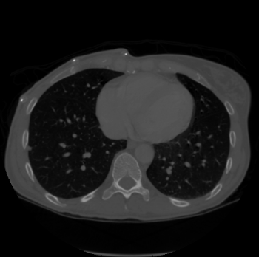
Introduction
Goal: Reduce the time to diagnose and improve the accuracy of cancerous nodule detection in CT scans of patient lungs using Convolutional Neural Networks
Notes:
Daniel
Include:
-Problem statement and dataset
-Picture of cancerous nodule

Slide 3
Past Work & Challenges
Training on LUNA/LIDC data only ⁴
Teams used LUNA data to identify and segment lung nodules
Nodules are labeled which adds information the Kaggle dataset did not have
LUNA data contained malignancy labels (1-5) for how cancerous nodules are
False positive reduction ⁶
Kaggle and LUNA datasets have mostly false positives
Lung segmentation to extract only lung regions from CT scans
Nodule annotation - manual, or supervised learning
Candidate selection ⁴
Various solutions dictate candidate selection - e.g. limit to 20 most informative scans
As part of preprocessing, can increase performance and help to avoid noisy data
Notes:
Daniel
Include:
-Past research
-Challenges with image processing and size of dataset

Slide 4
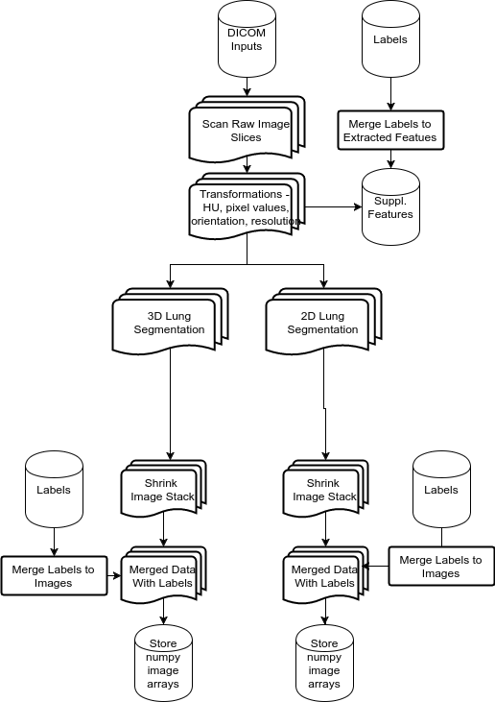
Image processing
Read data from DICOM files
Transformations - HU, rescale pixel values, adjust orientation, and standardize resolution
Segmentation of Lungs from background of image to remove noise (used multiple methods)
Extracted & stored info from image
Shrinked images to work well with CPU/GPU capacity
Merged to outcome labels
Notes:
Daniel
Include:
-Image processing techniques description
-Pipeline diagram

Slide 5
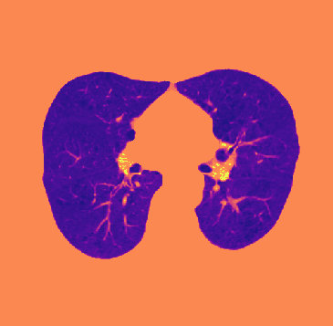
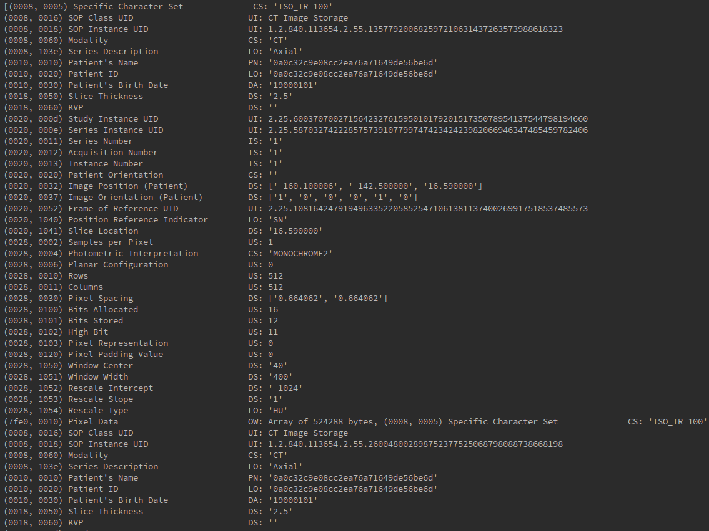
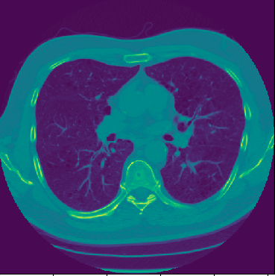
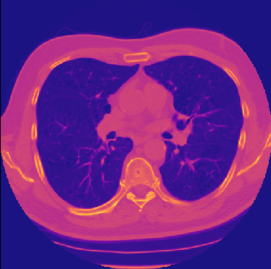
Image Processing Example
Transformations - HU, rescale pixel values, adjust orientation, and standardize resolution
DICOM files
Stacked Scan Slices from DICOM files
Lung Segmentation
Resize
Processing Steps
Notes:
Daniel
Include:
-Image processing techniques description
-Pipeline diagram

Slide 6
Convolutional Neural Networks (CNN)
CNN architectures
2D - Conv2D nets take in one image or slice
Keras used Tensorflow as the backend for more advanced models
Tools
Tensorflow was used for basic CNN architectures
Keras used Tensorflow as the backend for more advanced models
Cloud platform: NC6 Machine on Azure
GPU: NVIDIA Tesla K80
Notes:
We used multiple CNN architectures to test performance against. We tried 2D and 3D CNNs, where the only difference is the image passed in, 1 2D image, or an array of images that make a 3D object.
We trained on an NC6 Machine on Azure and used keras with tensorflow as the model building tools. An NVIDIA Tesls K80 GPU sped up computations very well.

Slide 7
Convolutional Neural Networks (CNN)
Processed Images
Reshape images into tensors with 1 color channel
Pass images to a Convolutional layer (2D or 3D)
A kernel window generates a subset of pixel values.
Max-pooling with a 2 x 2 kernel finds the max value from each patch that it processes to reduce feature size
The Fully Connected dense layer has all nodes connected
A Dropout layer is added with so that not all possible paths are computed each time
This technique has been proven to be effective in training neural networks given large parameter sizes and help avoid overfitting⁷
Softmax classifier fits to the FC layer and updates via gradient descent
Conv
Max Pool
Conv
Max Pool
Conv
Max Pool
Fully Connected
Dropout
Softmax Classifier
Output
Binary
Notes:
The basic CNN structure we utilized was feeding in preprocessed images to several convolutional layers, each with a max pool layer. The processed images were reshaped into a tensor for the first conv layer, which generates a subset of values based on a moving window over the image region.
The max pool layers aggregate values from conv layers to a lower dimension and as this process repeats we find more high level information about an image.
After these layers process, a fully connected layer which is flat and dense is fed into a dropout layer. Geoffrey Hinton devised this technique, and it helps to reduce overfitting and avoid all possible combinations in the connected network.
The last step is the softmax classifier which generates probabilities for the inputs and updates the network via gradient descent

Slide 8
2D CNN - Results
Different parameters produced the same results with 2D CNNs
Used base Tensorflow to implement , but always converged similarly
Test set accuracy was high, but logloss was greater than 25.0 each time
Epochs | Batch size | Dropout Rate | Learning Rate
15 | 10 | .4 | .01
30 | 10 | .6 | .01
50 | 10 | .7 | .001
Metric | Test
Accuracy | ~80%
Logloss | > 25.0
Notes:
Mitchell
Include:
-Results in table
-Observations
-Hyper parameter tuning

Slide 9
Pipeline
Cancer Labels
Binary
Kaggle
Processed Images
CNN
Classification
Kaggle
Processed Images
CNN
Model
Output
Binary
Notes:
Adnan
Here is what our processing pipeline looked like. It was apparent from the results that we had to change our strategy. We tried to adapt to some of the solutions used by top performers in the kaggle competition.

Slide 10
Modifications to Pipeline
Nodule Annotations
Coordinates
Kaggle Images
136x168x168
Cancer Labels
Binary
LUNA¹ Dataset
136x168x168
UNet² Segmentation
LUNA UNet Model
Kaggle
(Train)
Features
Conv3D
Classification
Kaggle
(Test)
Features
Conv3D
Model
Python
Similar image processing techniques
Keras - TensorFlow
UNet
3D CNN for classification
Output
Binary
Notes:
Adnan
So we took the LUNA CT scans and standardized to fit in GPU memory. We then trained using a 3D UNET model with the given nodule annotations. We will be discussing about Unet later. We then took the kaggle images and standardized them to the same format as LUNA and fed them to the UNET model. With the nodules segmented out, we then train a Convolutional 3D Neural Network for classification. Once we have a model trained, we use the test set to classify.
We used similar techniques and technologies as discussed before

Slide 11
Processing
UNET ²
Segmentation technique - Proven to be successful on 3D medical images
The network learns from these sparse annotations and provides a dense 3D segmentation - Uses a network of 3D CNN Layers with Relu
515 training images, trained over 5 epoch, took over 10 hours
Classification- 3D CNN
3 Layer Model with BatchNormalization and MaxPooling
Stochastic Gradient Descent Optimizer
SoftMax Classifier
80% training, 10% validation and 10% testing, training over 5 epoch, took over 8 hours
Notes:
Adnan
UNET is a segmentation technique proven to be successful on 3D medical images with sparse annotations. Due to limited time, we will not be able to go in all details of UNET, but it’s gist is to use a network of 3D Convolutional Neural Network layers.
<<NEXT>>
For classification, we used a 3 Layer 3D Convolutional Neural Network with a softmax classifier. This took over 8 hours to train on 5 epoch. Due to limited time, we were not able to experiment a lot with different classification techniques for this method.

Slide 12
3D CNN Results After Modifications
Metric | Test | Validation
Accuracy | 77.6% | 78.12%
AUC | 0.68 | 0.65
LogLoss | 0.59 | 0.60
Test Dataset
IsCancerous | Precision | Recall
False | 0.81 | 0.89
True | 0.64 | 0.48
Notes:
Adnan
The results for this method were also mixed. The test accuracy was around 78%. We performed a little better than random guessing with a AUC of around 0.68.
And here you we the precision and recall on the test dataset.

Slide 13
Conclusion
Mixed results using 3D Convolutional Neural Networks
Directly feeding processed images was not very successful mainly because of loss of data
Using LUNA dataset seems like a better approach because of better segmented features
Model trained on UNET can be improved
Better image processing techniques and normalization of dataset
Improved hyperparameter tuning
Improving on classification methods
Combining with 2D CNN
Challenging problem to solve
Imbalanced dataset
Lots of hyper parameters to tune on
Many ways to reconstruct CNN
Long training times even with GPUs
Notes:
Adnan
In conclusion our methods gave mixed results. Directly feeding processed images was not very successful because of loss of data. Using LUNA annotations seems like a better technique.
<<NEXT>>
We feel that the method has potential to be improved. We could certainly get better at image processing and normalizing the dataset. Improving hyperparameter tuning and improving 3D CNN architecture for classification and combining with 2D CNN could also help.
<<NEXT>>
This problem in general is challenging to solve. The dataset is fairly imbalanced. There are lots of hyperparameters to tune on. Convolutional neural networks can be constructed in various ways and long training times even with GPUs adds to the challenge.

Slide 14
References
LUNA Grand Challenge, 2016 https://luna16.grand-challenge.org
3D U-Net: Learning Dense Volumetric Segmentation from Sparse Annotation. Çiçek Ö., Abdulkadir A., Lienkamp S., Brox T. https://arxiv.org/abs/1606.06650
3D Segmentation U-Net, Kernel, Kaggle Data Science Bowl, 2016 https://www.kaggle.com/c/data-science-bowl-2017/discussion/31608
Predicting Lung Cancer Vansteenkiste E. 2016. https://eliasvansteenkiste.github.io/machine%20learning/lung-cancer-pred/
7th Place Overview https://www.kaggle.com/c/data-science-bowl-2017/discussion/31576
ZNET Lung Nodule Detection. Berens M, van der Gugten R, de Kaste M, Manders J, Zuidhof G. https://luna16.grand-challenge.org/serve/public_html/pdfs/ZNET_NDET_160831.pdf/
Dropout: A Simple Way to Prevent Neural Networks from Overfitting. Srivastava N, Hinton G, Krizhevsky A, Sutskever I, Salakhutdinov R. https://www.cs.toronto.edu/~hinton/absps/JMLRdropout.pdf
Notes:
Please add all references here..
Adnan
We will like to thank the professors and TAs for a great class, it has been a very good learning experience. Please don’t hesitate to email us if you have any questions. Thanks for watching!

